Slide 1
Language and Mind: Linguistics and cognitive studies
First annual meeting
WELCOME!

Slide 2
Who are we? The L&M community
We meet regularly (3 meetings every year) to discuss what we are doing, and what we are going to do
We support individual learning by close contact between students and professors
The Didactics Committee
– organizes and monitors the working of the didactic activities
– examines students’ requests about their study plans
– discusses issues raised by the students through their representatives
Valentina Bianchi (President) valentina.bianchi@unisi.it
Jan Casalicchio jan.casalicchio@unisi.it
Salvatore Pistoia Reda salvatore.pistoiareda@unisi.it
Giacomo Romano giacomo.romano@unisi.it
Miti Valeria Olivieri (student representative) m.olivieri18@student.unisi.it
Ali Yusuf Camci (student representative) a.camci@student.unisi,it
Sofia Goltsman (student representative) s.goltsman@student.unisi.it
Ebrahim Ahmanidia (student representative) e.ahmanidia@student.unisi.it
Notes:
Student.unisi

Slide 3
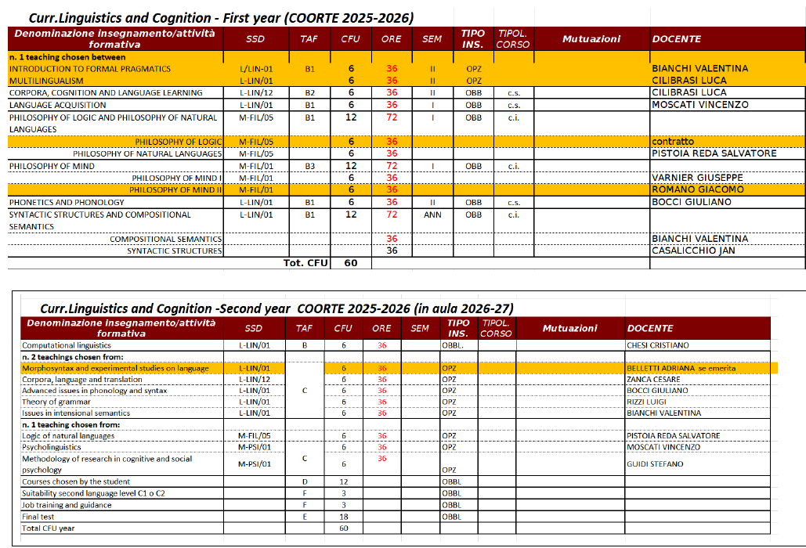
Study plan – cohort 2025-26
Notes:
Student.unisi

Slide 4
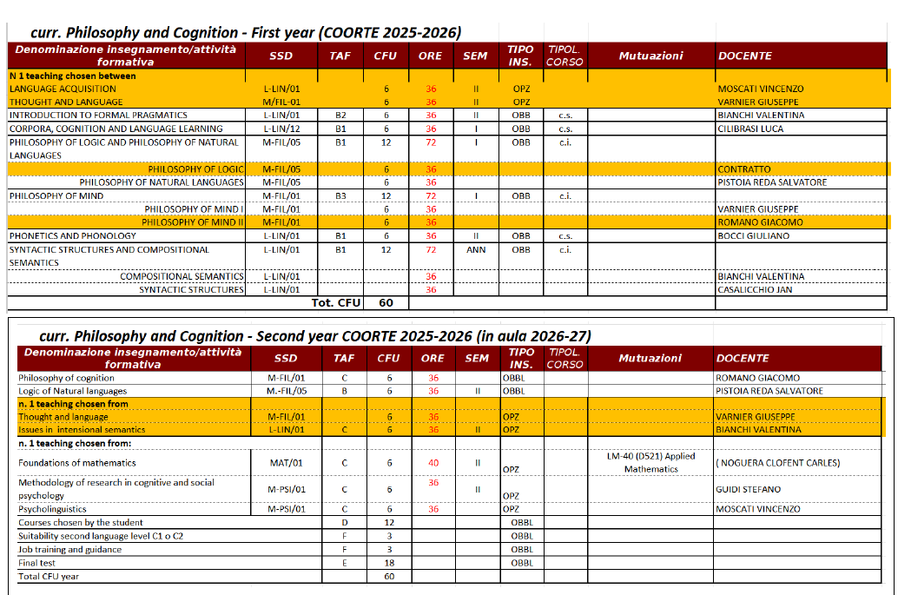
Study plan – cohort 2025-26
Notes:
Student.unisi

Slide 5
Evaluation of didactic activities
Towards the end of each module, you will be invited to fill in an evaluation questionnaire.
This is not compulsory, but it is crucial in order to identify any problems related to the course and improve the didactic activities.
The results of the questionnaires are available to each instructor, and if authorized by the instructor, also on the public webpage (alas, in Italian only):
https://www.unisi.it/didattica/rilevazione-opinione-studenti-e-studentesse
They are discussed in the L&M annual meeting that follows the publication of the results; in the meetings of the Teaching Committee, of the Teaching Board, of the students-professors Committee (CPSD) of the Department.
Any problems can also be communicated to the Teaching Committee through the student representatives
Also, in the second and the third annual meeting, during the discussion time.
Notes:
Student.unisi

Slide 6
Second year – common activities
Two «free choice» courses 12 credits
chosen by the student from the MA-level courses offered in English at the University:
– if chosen among L&M courses, they are automatically accepted
– if chosen from another program, the choice must be approved by the Committee
NB: Language courses at the CLA cannot be chosen as free credits.
Suitability English C1 (or C2) 3 credits
If not obtained in your previous studies, contact the CLA (https://www.cla.unisi.it/en)
NB. Other language courses can be registered as extra credits
Job training and guidance 3 credits
presentation of personal thesis project +
participation in research seminars and students’ thesis presentation sessions
Thesis project 18 credits
Notes:
Student.unisi

Slide 7
The research seminars
The Inter-University Center for Cognitive Studies on Language (CISCL) regularly organizes research seminars, both in presence and online, by the researchers of the center and by guests:
www.ciscl.unisi.it/events
Online seminars are also offered by the Milan branch of the Center (BIL group).
The seminars are announced via the Newsletter, and also on the CISCl website (section events).
Notes:
Student.unisi

Slide 8
The thesis project
The thesis project is assigned 18 credits
It is supervised by one L&M professor (relatore)
possibly with a co-supervisor (also external) (co-relatore)
Thesis reviewed by one L&M professor (contro-relatore)
and discussed in a public defense (see academic calendar).
The thesis is, on average, 70-100 pages:
- theoretical discussion / critical overview of the literature on a topic
- experimental thesis
See in Moodle: Language and Mind – thesis projects (password: LandM)
For a step-by-step guide.
Notes:
Student.unisi

Slide 9
Extra credits and internships
In addition to the regular 120 credits, it is possible to take extra exams up to 24 credits.
The choice of exams must be approved by the Committee.
The extra credits are recorded in the student’s diploma supplement (they are not computed in the average for the final degree).
Internships must be supervised by a professor:
Internships at the Experimental Linguistics and Syntactic Cartography Lab
are supervised by the Director (prof. Moscati) – 4 per semester
possibly co-supervised by another L&M professor (no limit)
→ they add an “open badge” on collection and processing of linguistic data to the diploma supplement (in preparation)
Other internships must be supervised by a professor;
they must be approved by the Committee;
they are recorded in the curriculum as extra credits.
Notes:
Student.unisi

Slide 10
The double degree program
UNIVERSITÀ DI SIENA – Language and Mind: Linguistics and Cognitive Studies
UNIVERSITÉ PARIS 1 PANTHEON-SORBONNE - Master « Philosophie», parcours « Logique et Philosophie des Sciences». Language of teaching: French (minimum level required: B1)
In their first-year students in the MA Language and Mind. Linguistics and cognitive studies have the opportunity to participate in the selection for a Double Degree program with the Université Paris 1 Panthéon - Sorbonne.
Successful candidates spend their second year at the Université Paris 1 Panthéon - Sorbonne.
The thesis is written in French or in English and discussed in both Universities.
Participation in the Double Degree favors the gain of further perspectives on topics related to logic, philosophy of science, cognitive and language studies developed in Paris.
PROGRAM COORDINATORS
University of Siena - Prof. Salvatore Pistoia Reda
Université Paris 1 Panthéon-Sorbonne - Prof. Maximilian Kistler
Notes:
Student.unisi

