Slide 1
Linguistics & Cognition
Philosophy & Cognition
Practical information for freshmen

Slide 2
Linguistics & Cognition
Philosophy & Cognition
The syllabi
The syllabus of each teaching can be found at:
https://language-mind.unisi.it/en/study/subjects/subjects-ay-2024-2025
then clicking on each course name. (NB: only for modules with an instructor)
Read carefully each syllabus, especially to learn about the didactic objectives and the related modality of exam.
You also find the course contents, the bibliography, and additional info.

Slide 3
Linguistics & Cognition
Philosophy & Cognition
The exams
Each professor decides on the modality according to their didactic objectives:
i. Written test
ii. Oral (face-to-face) exam, class discussion
iii. Seminar (presentation to the class) or written essay on a selected topic
iv. Project
Top grade: 30/30 (cum laude). 18 is the minimum grade to pass the exam.
Calendar of exam periods: https://www.dispoc.unisi.it/en/teaching/calendar-courses
Sign up for an exam date on segreteriaonline.unisi.it (UNISi password) or through the app.
You can take an exam as many times as needed to reach the didactic objectives.

Slide 4
Linguistics & Cognition
Philosophy & Cognition
The didactic platform
You can access the didactic platform with your UNISI account:
elearning.unisi.it
or temporarily through the «guest» mode (if activated by the professor).
Some courses have a password (ask the professor if you missed it).
Each professor decides on which materials to make available, whether to assign homework or do intermediate tests, according to the relevant didactic objectives
Professors’ office hours are announced on their personal pages (check for any changes):
https://www.dispoc.unisi.it/en/department/staff

Slide 5
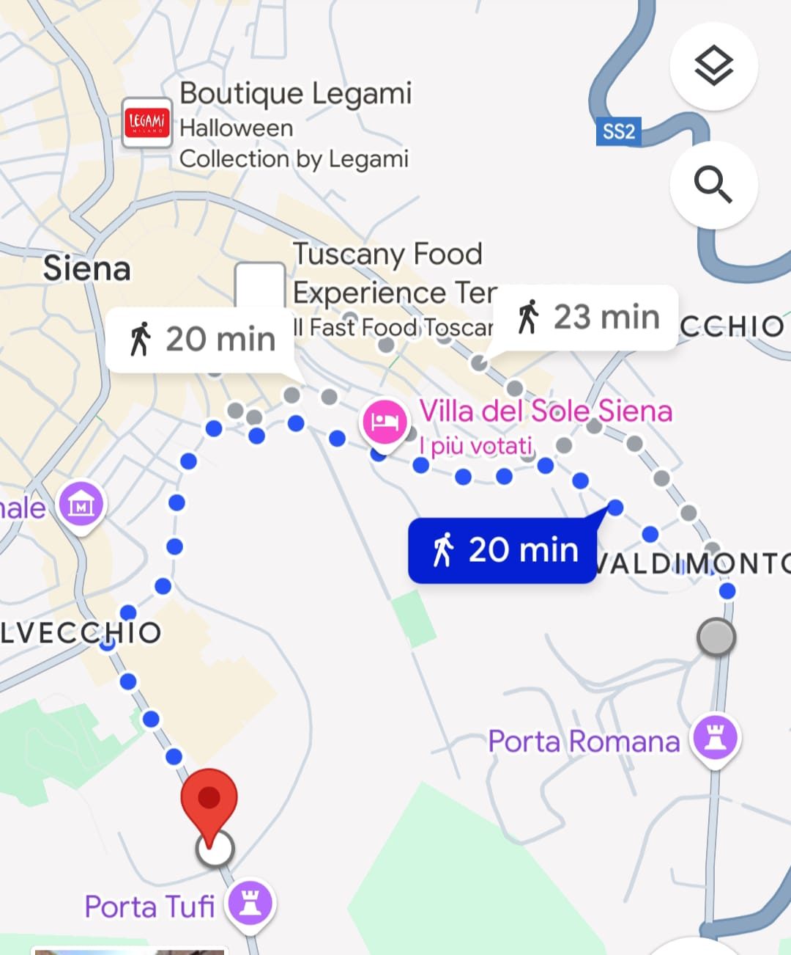
Linguistics & Cognition
Philosophy & Cognition
The didactic secretariat
The didactic secretariat is located in via Mattioli 10
(underground floor):
Studenti.mattioli@unisi.it
Appointments are booked through the UNISI app.

Slide 6
Linguistics & Cognition
Philosophy & Cognition
Information for second year students

Slide 7
Linguistics & Cognition
Philosophy & Cognition
Thesis projects
It is important to start thinking about a thesis project as soon as possible
… especially if you may run out of funding or finish the scholarship at the end of the second academic year.
Possible thesis topics typically come to mind during the classes. Anyway…
… professors are always available, during the office hours, to discuss possible thesis topics.
Everything starts with an initial brainstorming!
You may also do part of your thesis research at the laboratory.
See the Moodle module: Language and Mind – Thesis projects for general information:
https://elearning.unisi.it/course/view.php?id=9716
Password: LandM
To be discussed also in a dedicated meeting (december?) and during the second annual meeting.

Slide 8
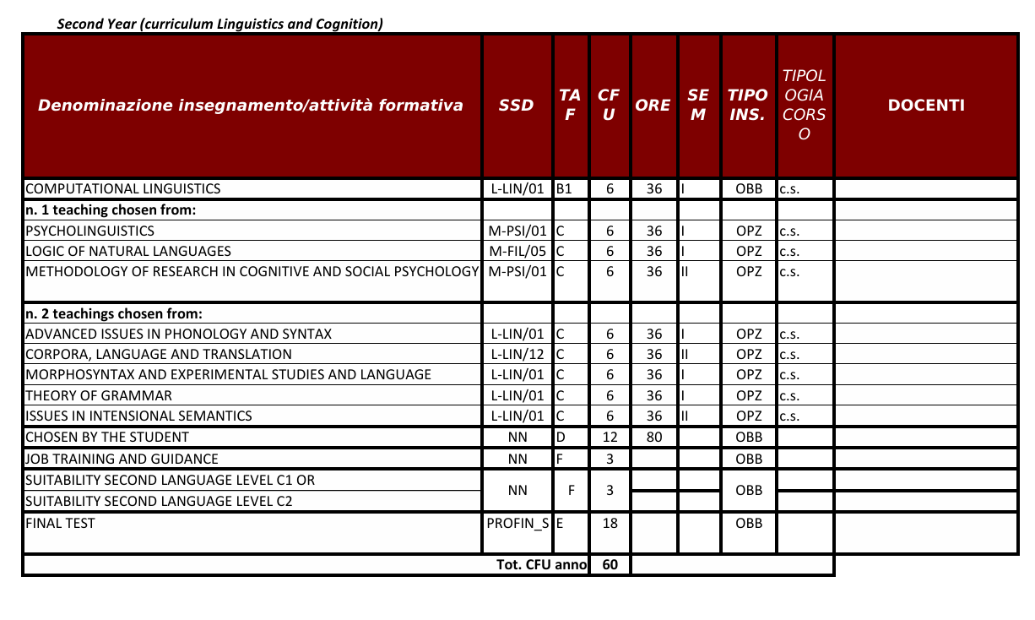
Linguistics & Cognition
Philosophy & Cognition
Study plan second year

Slide 9
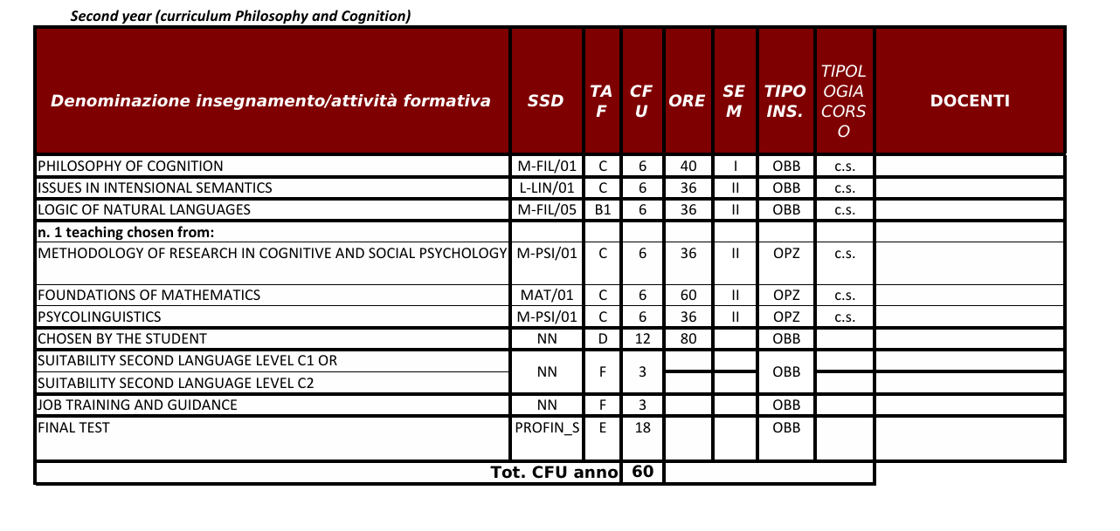
Linguistics & Cognition
Philosophy & Cognition
Study plan second year

Slide 10
Linguistics & Cognition
Philosophy & Cognition
Erasmus scholarships
Call published here: https://en.unisi.it/international/mobility-abroad
Students who are granted an Erasmus exchange scholarship must prepare a Learning Agreement Before the Mobility, whose approval by the L&M Teaching Committee is a condition for the grant to become effective.
Each Erasmus agreement has a local coordinator in Siena. If the local coordinator of your Erasmus exchange is a L&M professor, you must as soon as possible discuss with him/her your LA Before the Mobility, so as to select relevant didactic modules at the host institution that suitably replace corresponding modules in the L&M study plan. You are also encouraged to select possible alternatives for modules that might replace the selected ones, in case your LA has to be changed during the mobility period.
If the local coordinator is not a L&M professor, you must contact a professor member of the L&M Teaching Committee to discuss your LA with him/her to the same effect. This preparatory step will maximize the chances for your LA Before the Mobility to be approved by the Teaching Committee.
When the LA is ready, you will submit it for approval to the Committee through the didactic secretariat (student.mattioli@unisi.it). You should submit your LA at least two months before the planned date for leaving, keeping in mind that the Teaching Committee meets once every month (usually around the 20th).

Slide 11
Linguistics & Cognition
Philosophy & Cognition
Erasmus scholarships
Learning Agreement During the Mobility.
If, for any reason, you realize that you must change your LAduring the mobility period, you must as soon as possible contact one professor member of the Teaching Committee to discuss with him/her the options for suitable changes.
You should not choose a replacement without consultation under the naive assumption that any changes will be approved no matter what. A serious and careful consideration under the guidance of the L&M professor will maximize the chances for your LA During the Mobility to be approved by the Teaching Committee.
When the revised LA is ready, you will submit it for approval through the didactic secretariat (studenti.mattioli@unisi.it).

Slide 12
Linguistics & Cognition
Philosophy & Cognition
Erasmus scholarships
Learning Agreement for thesis research. If you intend to devote your time at the host institution to carry out research for a thesis project, before submitting your LA to the Teaching Committee, you must first define your thesis project with a L&M supervisor and discuss with him/her the research activities that you will carry out at the host institution.
The supervisor will issue a statement concerning the research activities planned and will indicate a referent at the host institution; this will constitute the basis for the Teaching Committee’s decision about the approval of your LA. Again, you should submit your LA for approval at least two months before the planned date of leaving.
When your period at the host institution is completed, you will need a statement both from the host institution and from your supervisor about the research activities that you have carried out. These documents too must be approved by the Teaching Committee.

Slide 13
Linguistics & Cognition
Philosophy & Cognition
C1/C2 level proficiency in English
If you obtained a C1 or C2 certification during your previous studies, you can ask for attribution of the 3 credits through request to the Teaching Committee (again, through studenti.mattioli@unisi.it)
If you got a C1 or C2 certification outside your academic curriculum, ask the the Language Center:
https://www.cla.unisi.it/en

Slide 14
Linguistics & Cognition
Philosophy & Cognition
Have a nice academic year!

